Slide 1
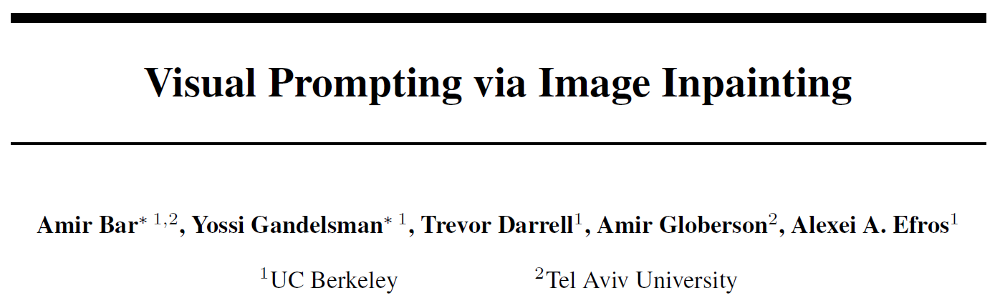
Published in NeurIPS 2022
Mingle Xu
2023 Jan 6

Slide 2
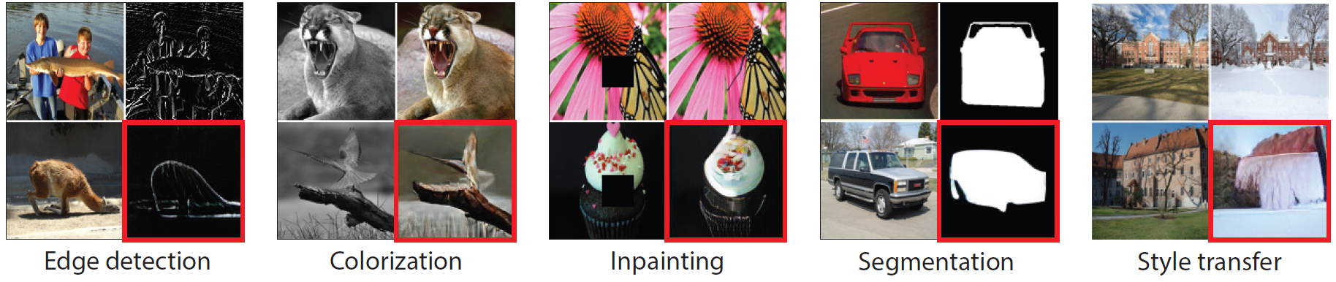
Introduction
After pretraining a model, can we do multiple tasks without finetuning or modification?
For a new task.
Training: one input and output.
Testing: one input.
Bar, Amir, et al. "Visual prompting via image inpainting." NIPS 2022.

Slide 3
Content
Transfer learning and its challenges
Zero-shot learning and visual prompting engineering
Today’s sharing paper: visual prompting via image inpainting

Slide 4
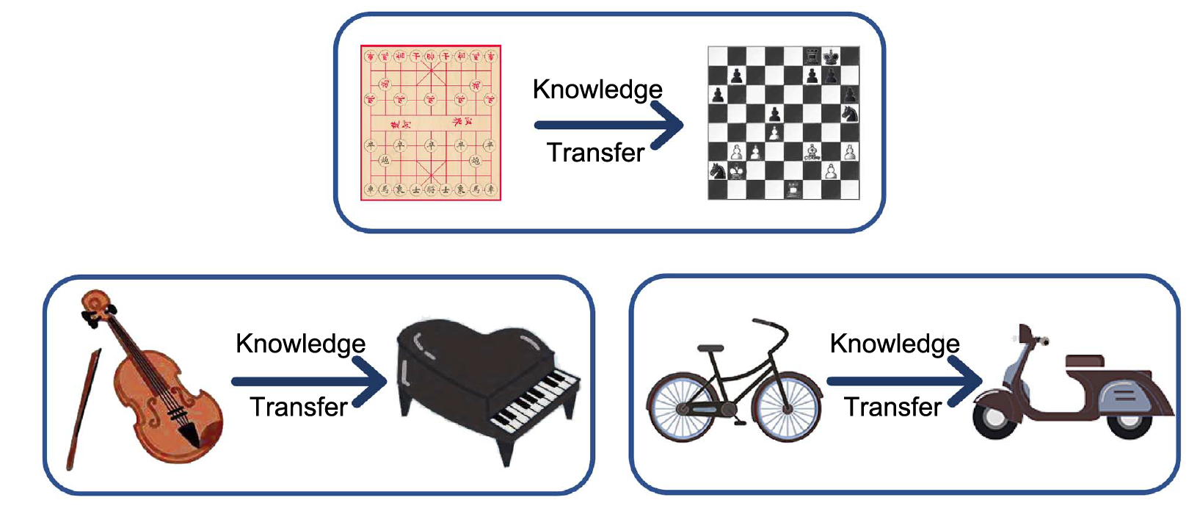
Background: Transfer Learning
Multitask viewpoint: transfer knowledge from one task to another.
Source task
Target task
Source dataset
Target dataset
Zhuang, Fuzhen, et al. "A comprehensive survey on transfer learning." Proceedings of the IEEE 109.1 (2020): 43-76.

Slide 5
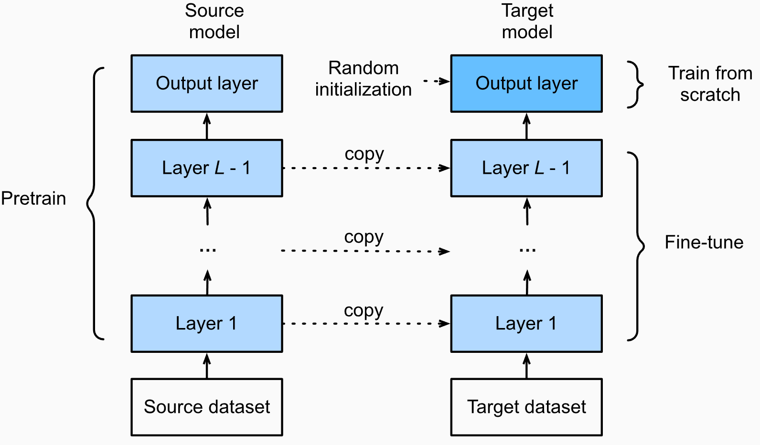
Background: Transfer Learning in CNN
Fine-tuning: widely used protocol with transfer learning in deep learning era
Basic assumptions:
Source dataset is huge but the target dataset is small
The target dataset is similar to the source dataset
Step 1: pretrain a model with a source dataset.
Step 2: discard the classifier and add a new one.
Step 3: fine-tune the model with a target dataset.
Step 4: test in the testing target dataset with the fine-tuned model.
Picture link: https://d2l.ai/chapter_computer-vision/fine-tuning.html

Slide 6
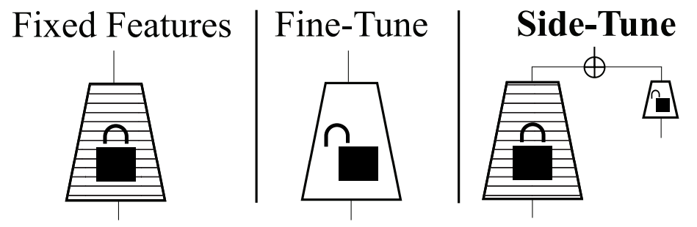
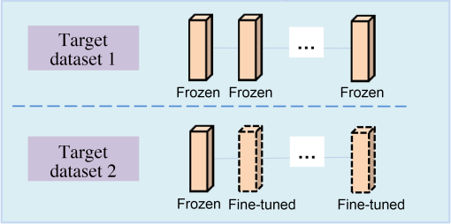
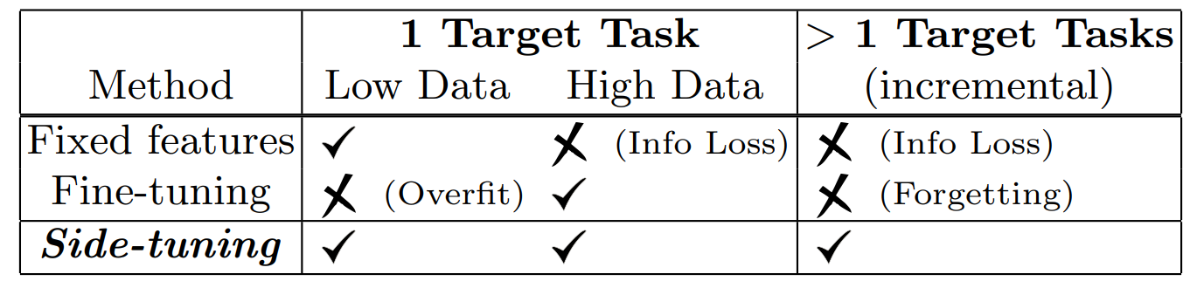
Background: Transfer Learning in CNN
Key issues: similarity, computation, and size of target datasets.
Similarity between the source and target dataset
Similar
Share more knowledge
Freeze less and fine-tune more layers
Not similar
Share less knowledge
Freeze more layers
Computation
RseNet50: 24M
ResNet152: 59M
ViT-base: 86M
ViT-large: 307M
ViT-huge: 632M
Zhang, Jeffrey O., et al. "Side-tuning: a baseline for network adaptation via additive side networks." ECCV, 2020.

Slide 7
Zero-shot learning: does not need retraining or finetuning.
From CNN to foundation model.

Slide 8
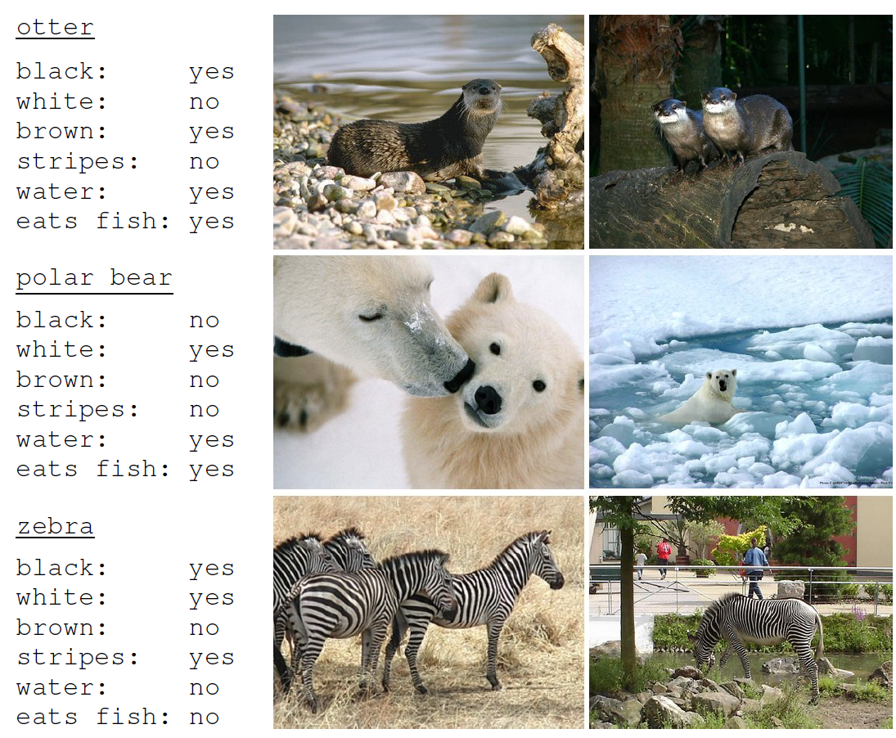
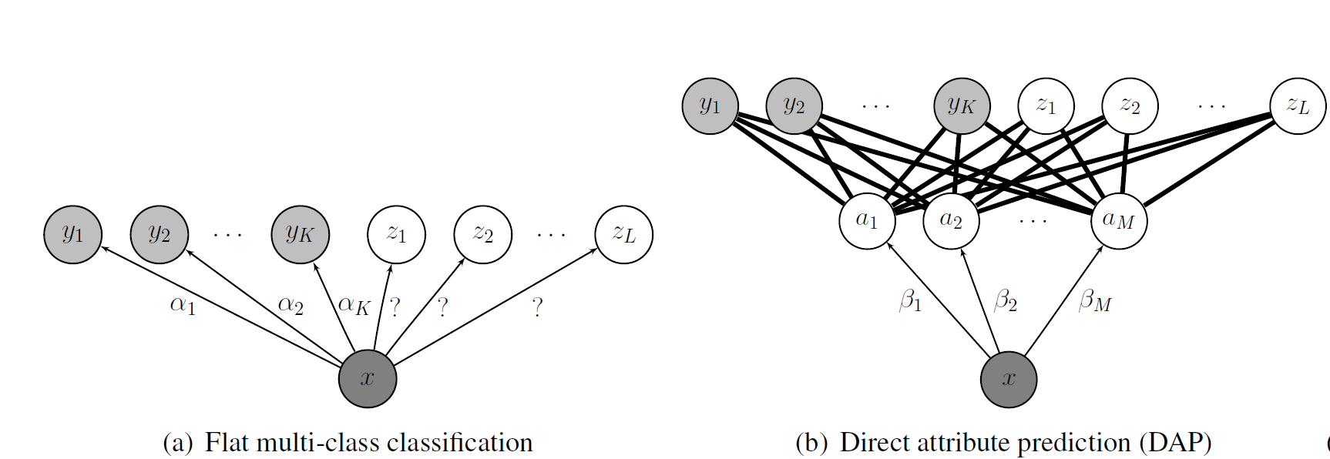
Background: zero-shot learning
Recognizing new objects in the testing process based on attributes without retraining or finetuning.
Lampert, et.al. "Learning to detect unseen object classes by between-class attribute transfer.“ 2009 CVPR

Slide 9
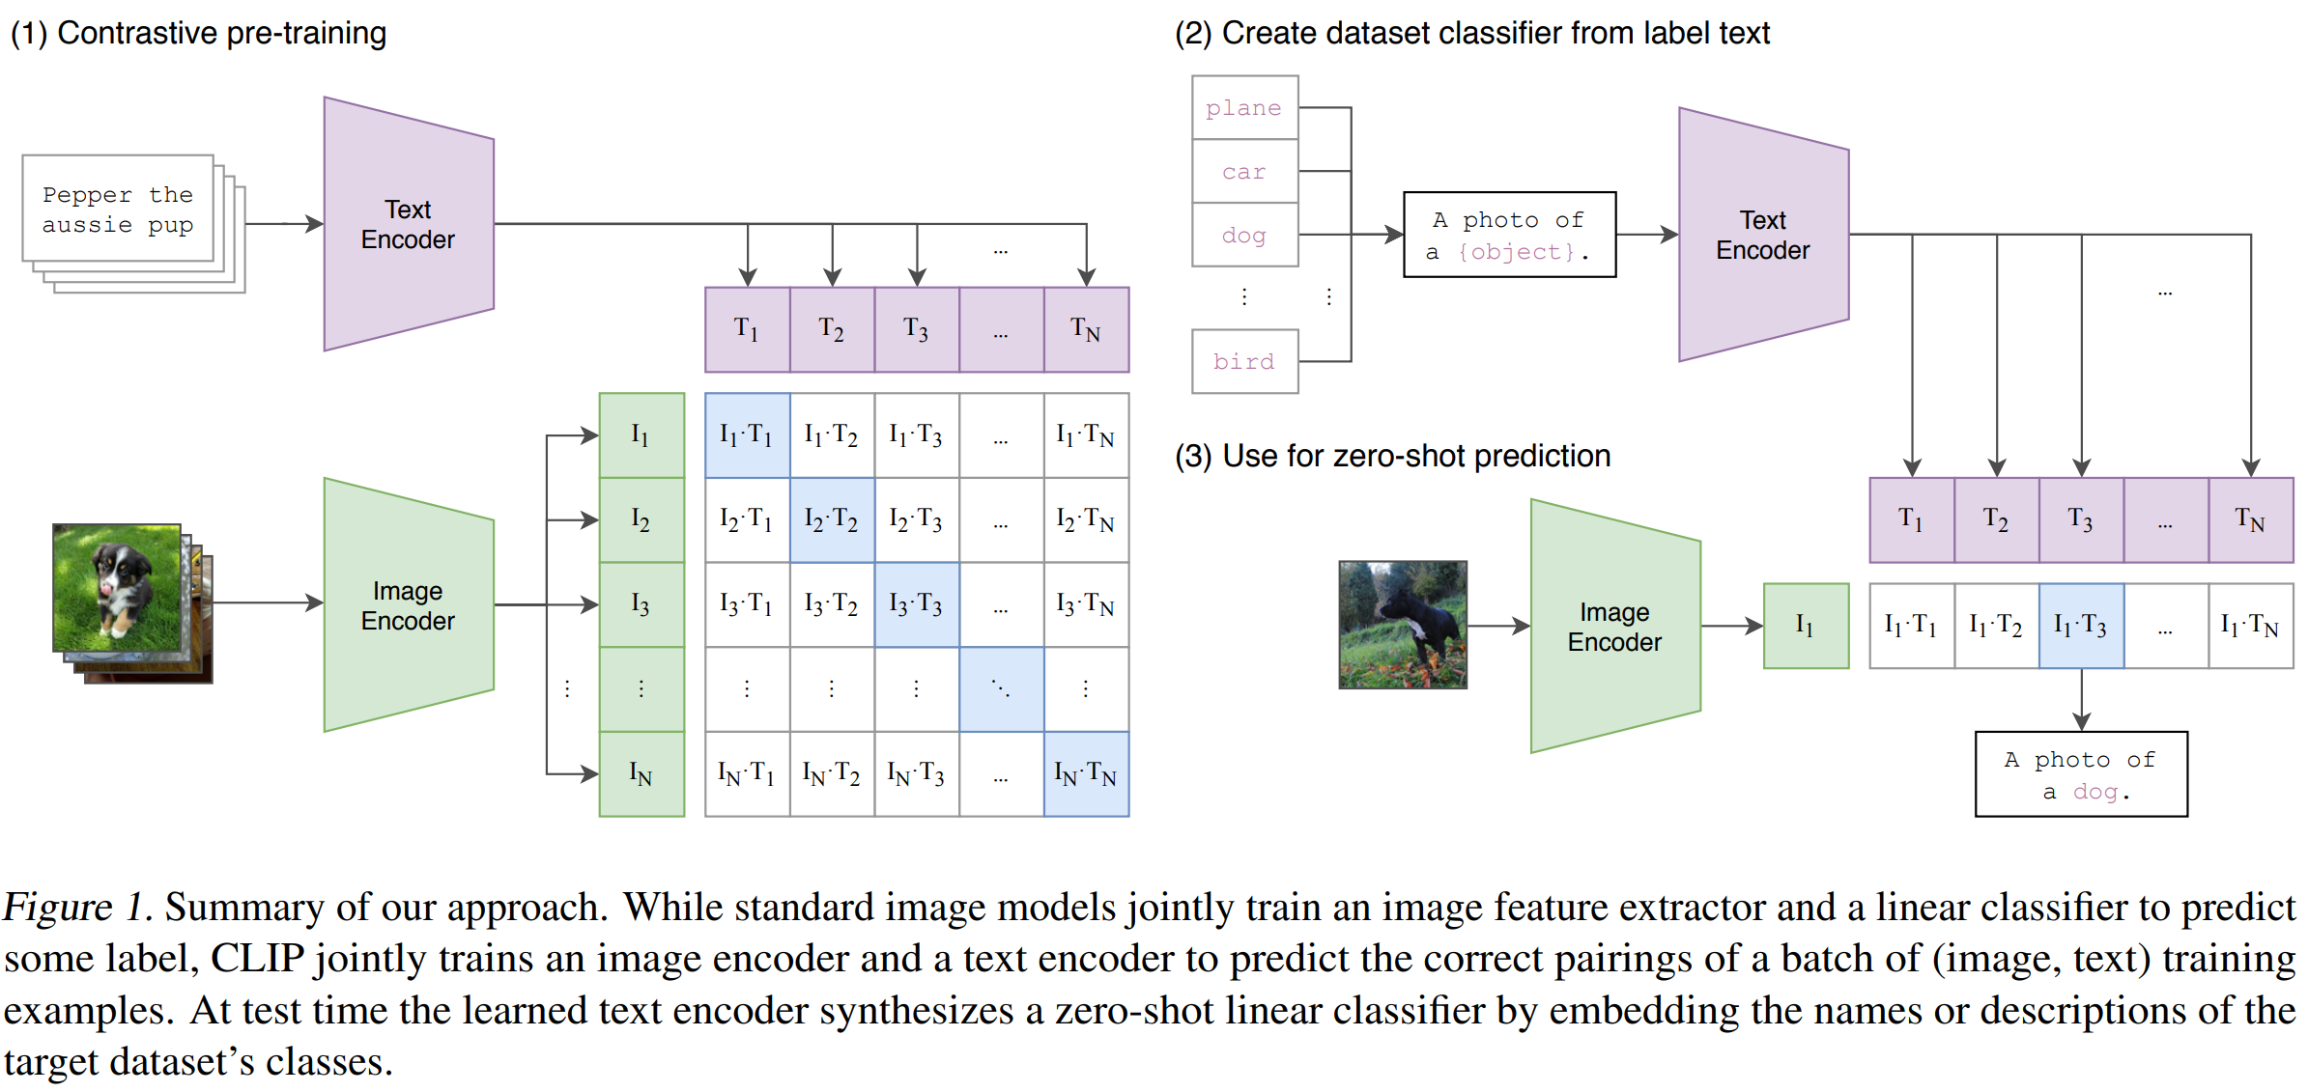
Background: Transfer Learning in Foundation Model
Foundation models may have better features and other conveniences.
Languages have higher semantic information than pictures.
Radford, Alec, et al. "Learning transferable visual models from natural language supervision." ICML, 2021.

Slide 10
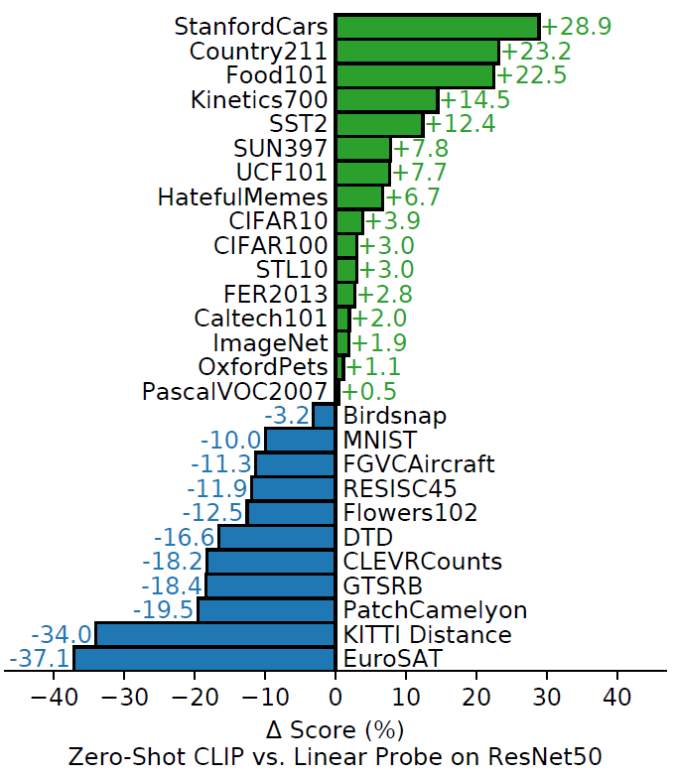
The highlight for CLIP: dataset and prompting engineering
CLIP: zero-shot object → zero-shot dataset
Objects may already be seen by the model.
No train and direct test
Training dataset: WIT (WebImageText), 400 million pairs of images and texts, collected from the website.
When the target dataset is not like the source dataset, the performance is bad.
Satellite image
lymph node tumor
Satellite image

Slide 11
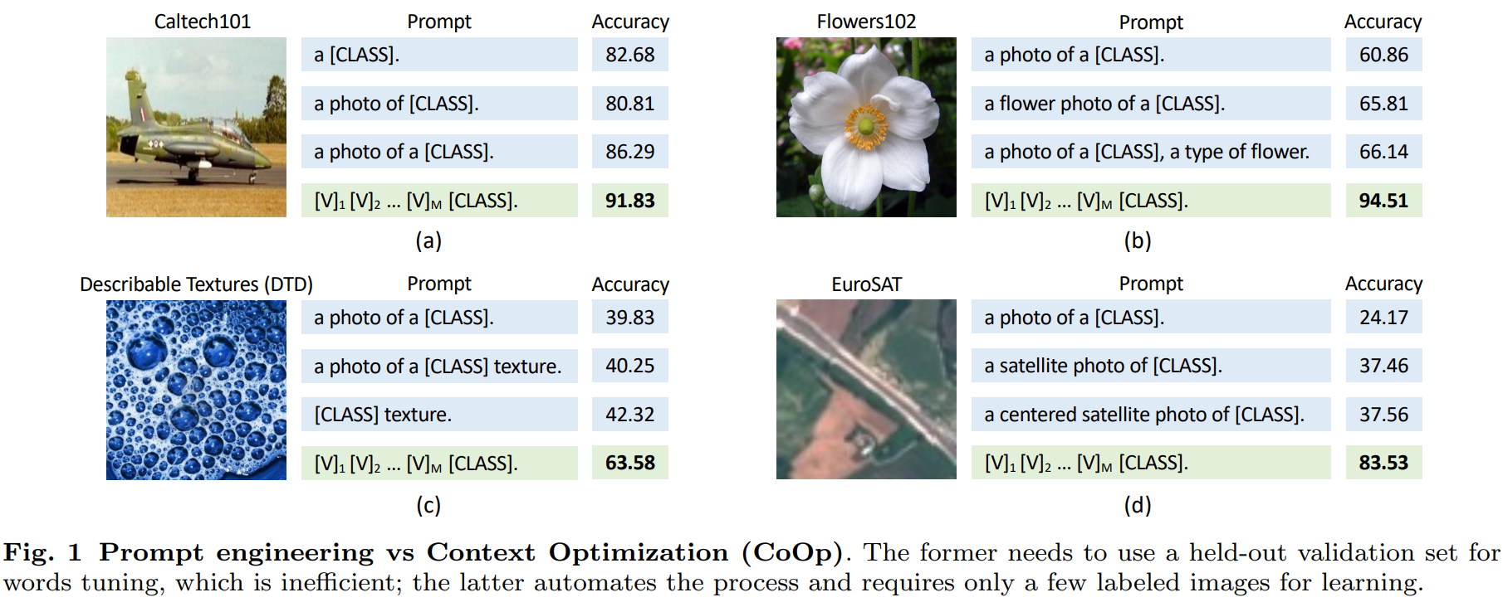
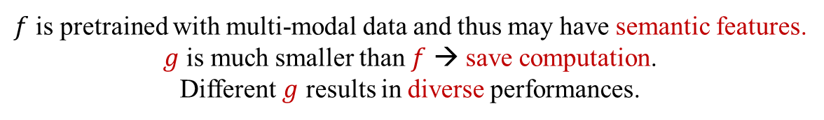
Background: Prompting Engineering
The zero-shot data is achieved with prompting engineering.
$y=f\left(x\right)$ → $y=f(x,g(x))$
$f$ is pretrained with multi-modal data and thus may have semantic features.
$g$ is much smaller than $f$ → save computation.
Different $g$ results in diverse performances.
Can we learn visual prompting?

Slide 12
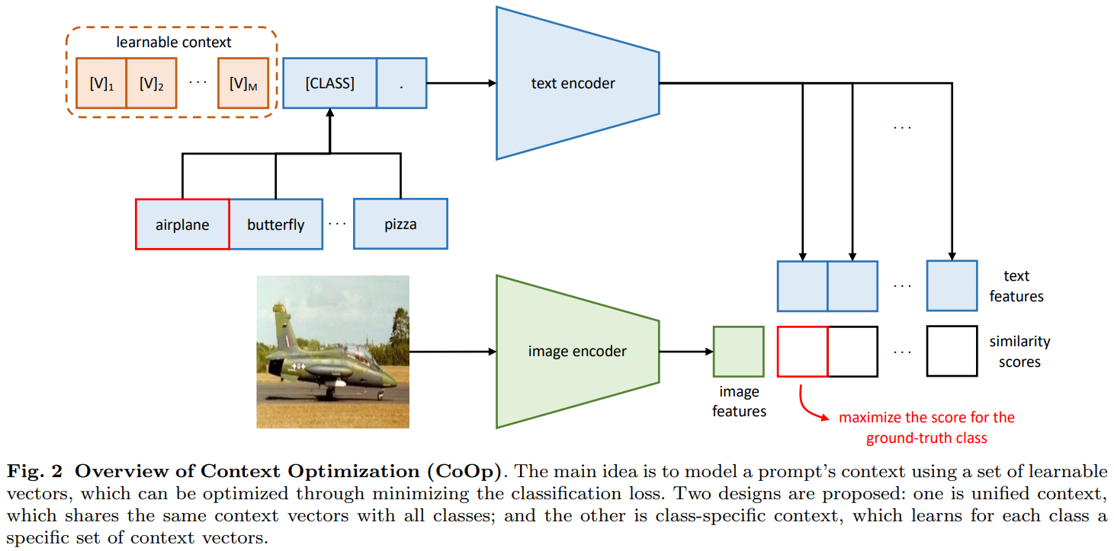
Background: Transfer Learning in Foundation Model
Learning the prompting
Zhou, Kaiyang, et al. "Learning to prompt for vision-language models." IJCV 2022.

Slide 13
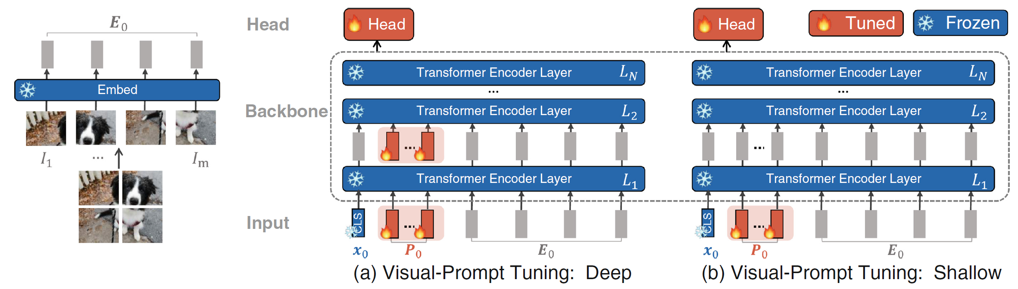
Background: Visual Prompting Engineering
Learning visual prompting, saving computation than finetuning.
Jia, Menglin, et al. "Visual prompt tuning." ECCV 2022

Slide 14
Background: Transfer Learning in Foundation Model
Learning the prompting
Zhou, Kaiyang, et al. "Learning to prompt for vision-language models." IJCV 2022.

Slide 15
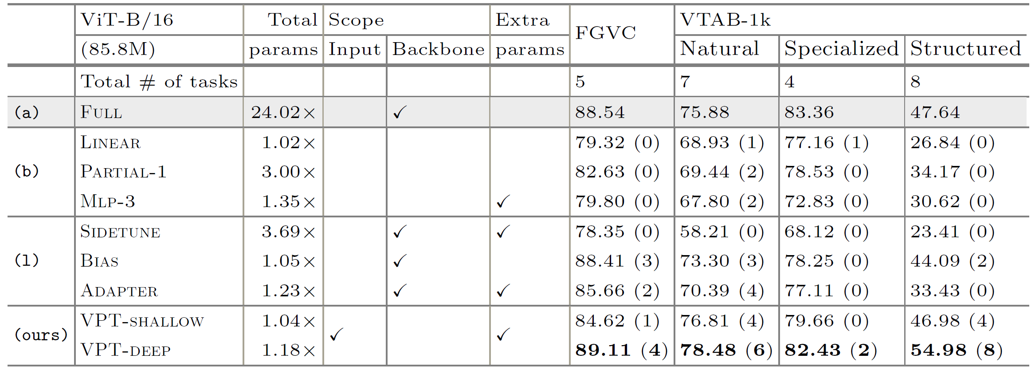
Background: Visual Prompting Engineering
Learning visual prompting
Jia, Menglin, et al. "Visual prompt tuning." ECCV 2022

Slide 16
A Quick Summary and Motivation
Multimodal pretraining leads to a good semantic feature space.
Learning visual prompting still needs learning or training.
Without finetuning or model modification.
Jia, Menglin, et al. "Visual prompt tuning." ECCV 2022

Slide 17
Published in NeurIPS 2022
Mingle Xu
2023 Jan 6

Slide 18
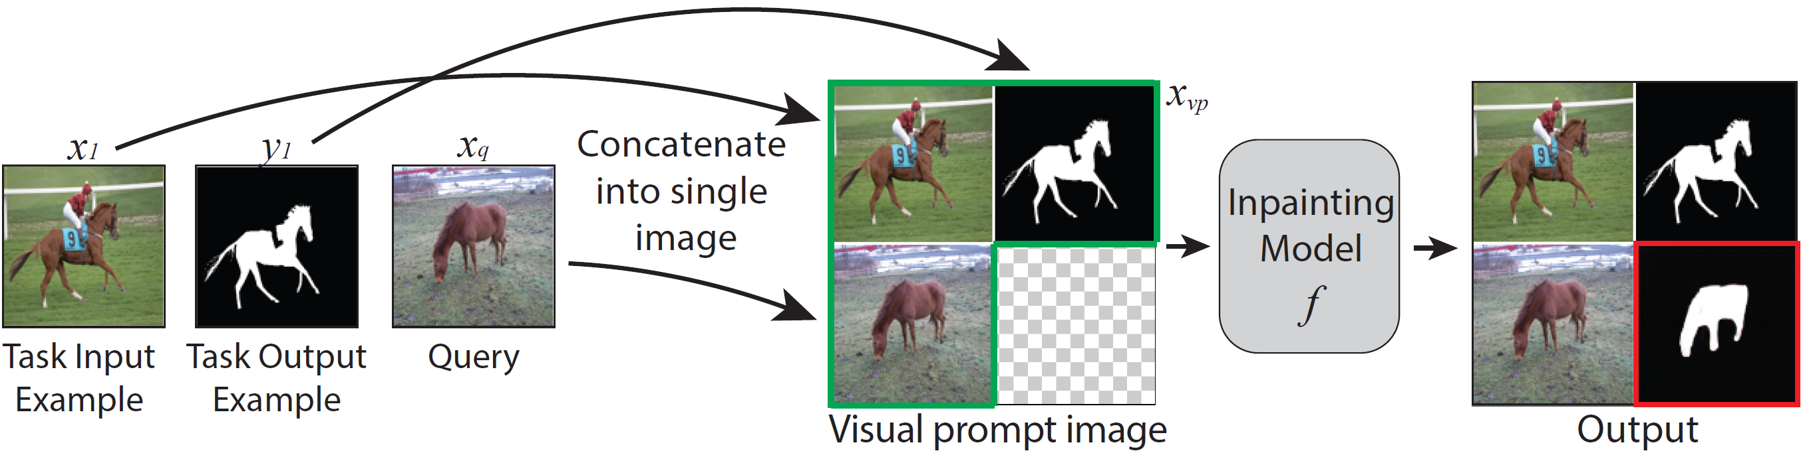
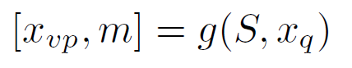
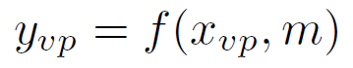
Proposed Method
Visual prompting via image inpainting.
Multiple inputs: $\left(n+1\right)∗2$ rows, fixed size of final output.

Slide 19
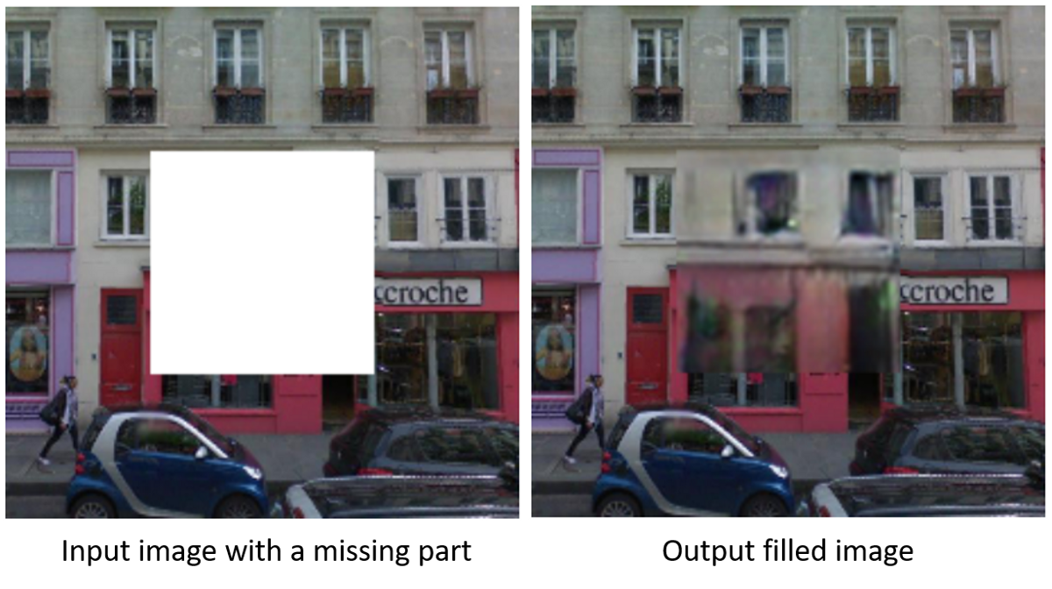
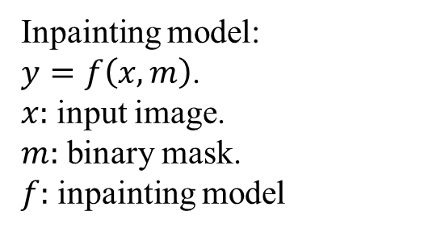
Background on Inpainting Model
Inpainting model:
$y=f\left(x,m\right)$.
$x:$ input image.
$m:$ binary mask.
$f:$ inpainting model
Pathak, Deepak, et al. "Context encoders: Feature learning by inpainting." CVPR, 2016.

Slide 20
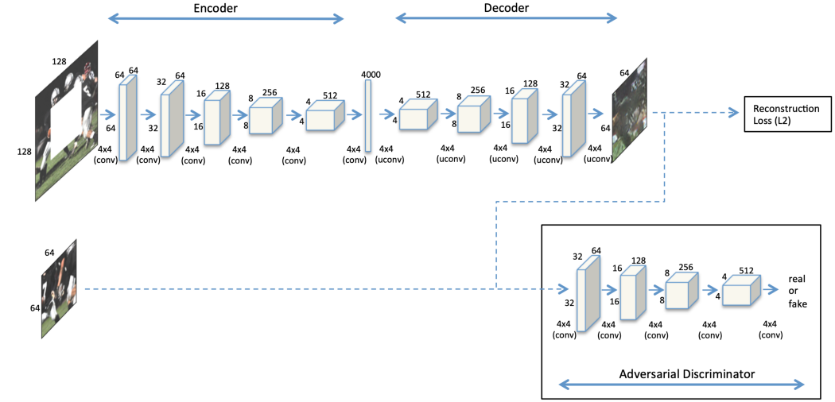
Pathak, Deepak, et al. "Context encoders: Feature learning by inpainting." CVPR, 2016.

Slide 21
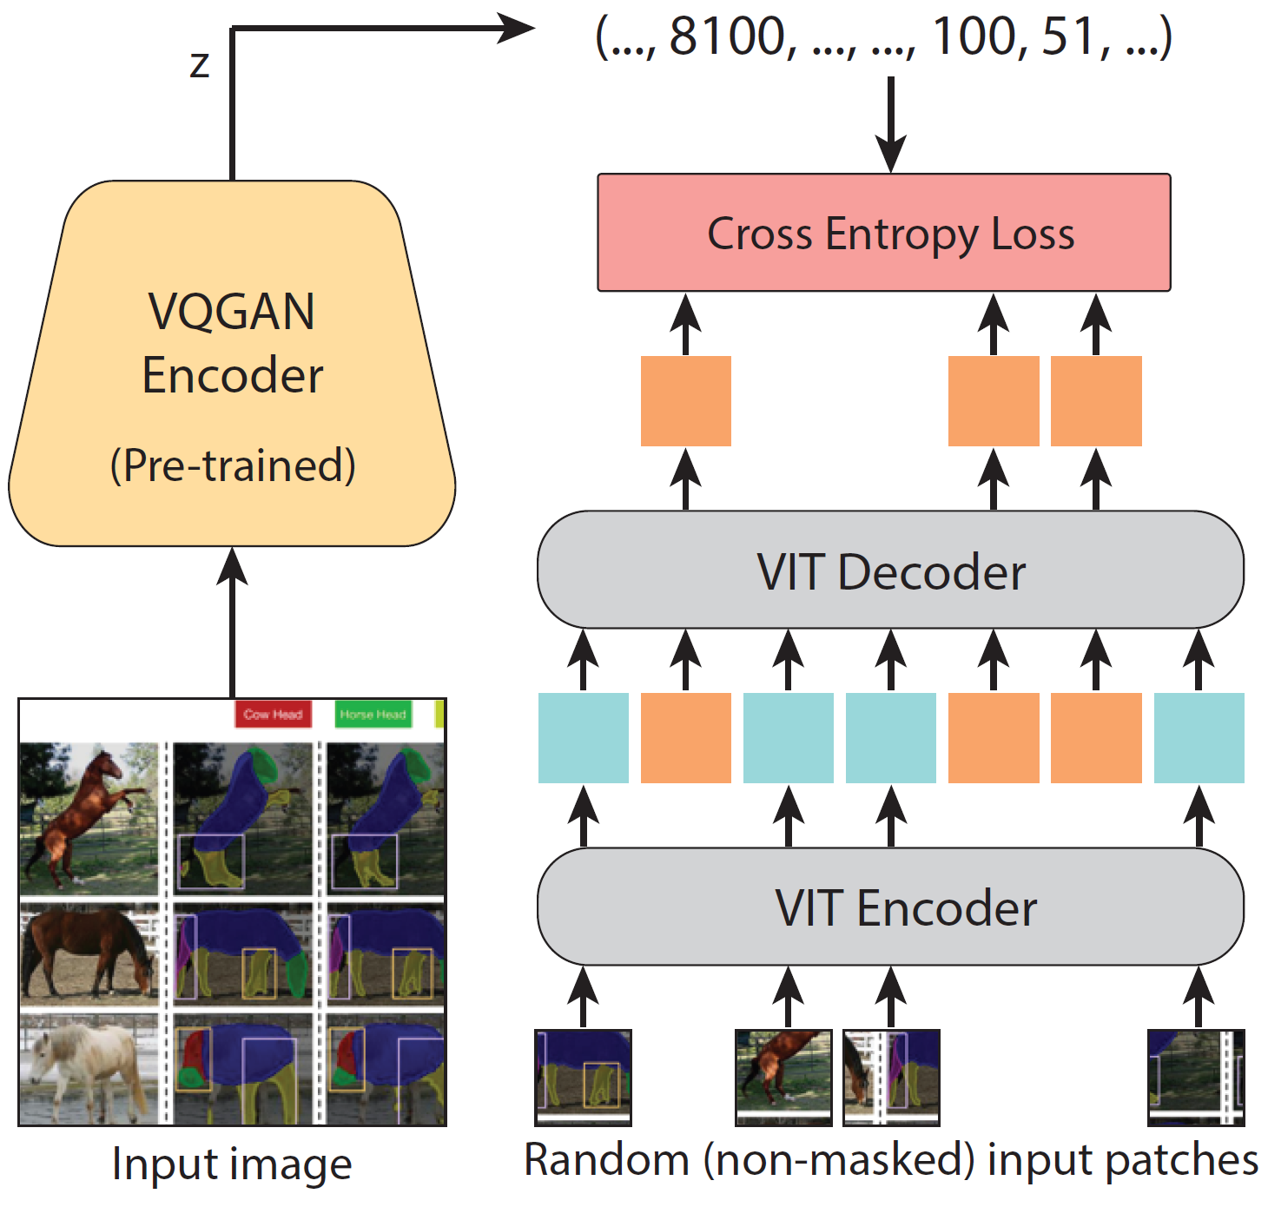
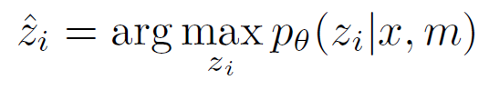

Proposed Method: Model and Pretraining Process
VQGAN is pretrained in ImageNet.
ViT encoder and decoder are trainable.
$$y=VQGAN_{D}(\hat{z})$$

Slide 22
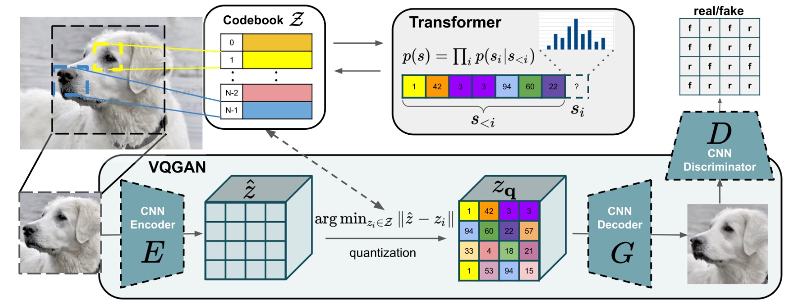
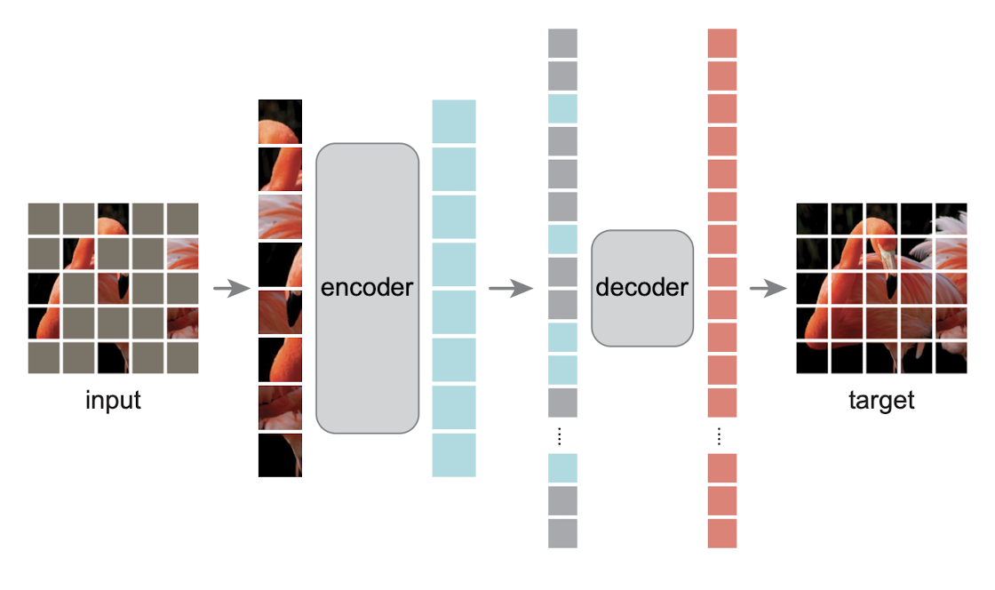
Van Den Oord, Aaron, and Oriol Vinyals. "Neural discrete representation learning." NIPS, 2017.
Esser, Patrick, Robin Rombach, and Bjorn Ommer. "Taming transformers for high-resolution image synthesis." CVPR, 2021.
He, Kaiming, et al. "Masked autoencoders are scalable vision learners." CVPR, 2022.

Slide 23
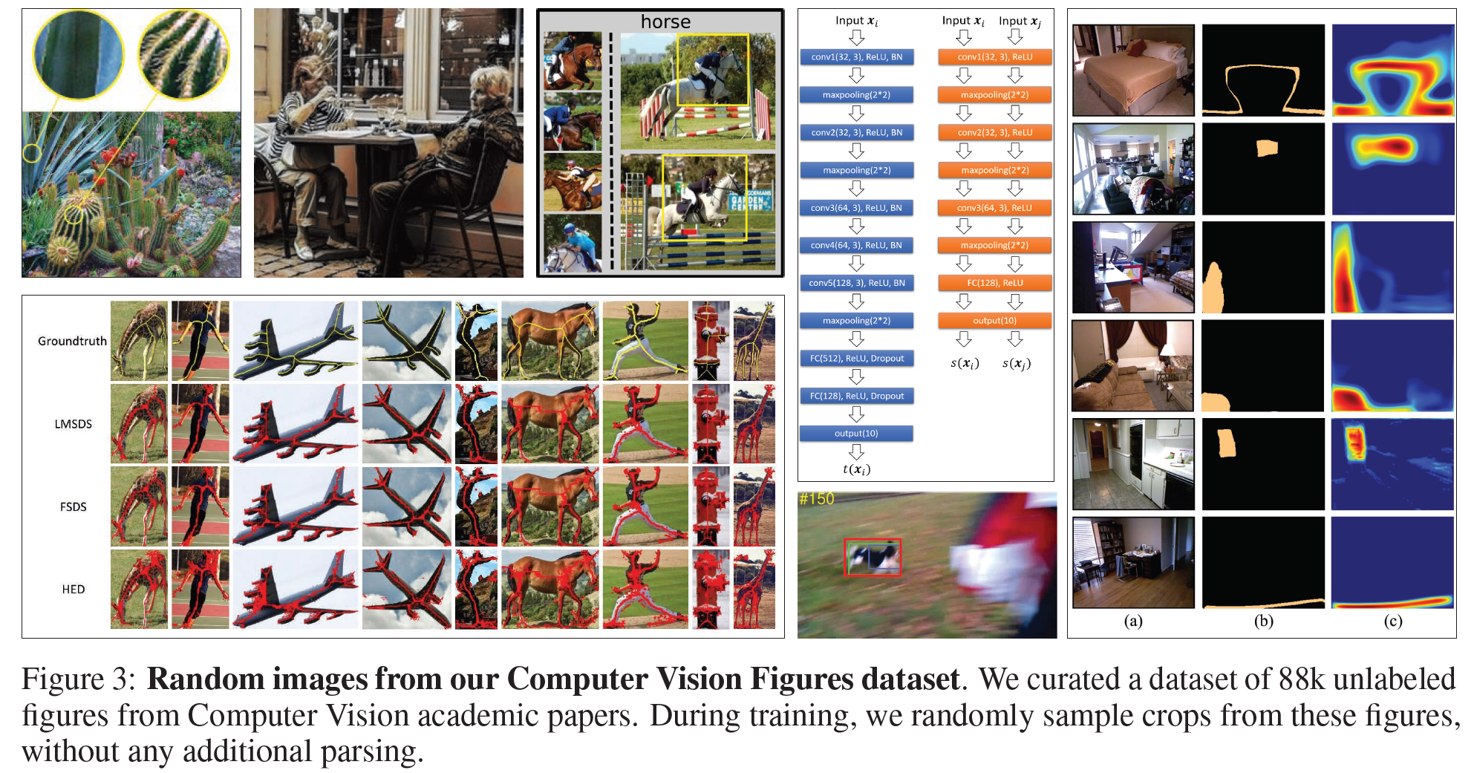
Proposed Method: Figures Dataset
Visual prompting images are not natural.
Computer Vision Figures dataset (Figures)
88,645 images.
Collected from scholarly articles in ArXiv.
Grid structure.

Slide 24
Proposed Method: Summary
Pretraining process:
Freeze the encoder and decoder in VQGAN trained in ImageNet
Use Figures dataset, with grid structure
Train a ViT encoder and decoder.
Testing process:
Make vision prompting
Use the ViT encoder and decoder to get latent vector
Use VQGAN decoder to obtain the inpainting image.

Slide 25
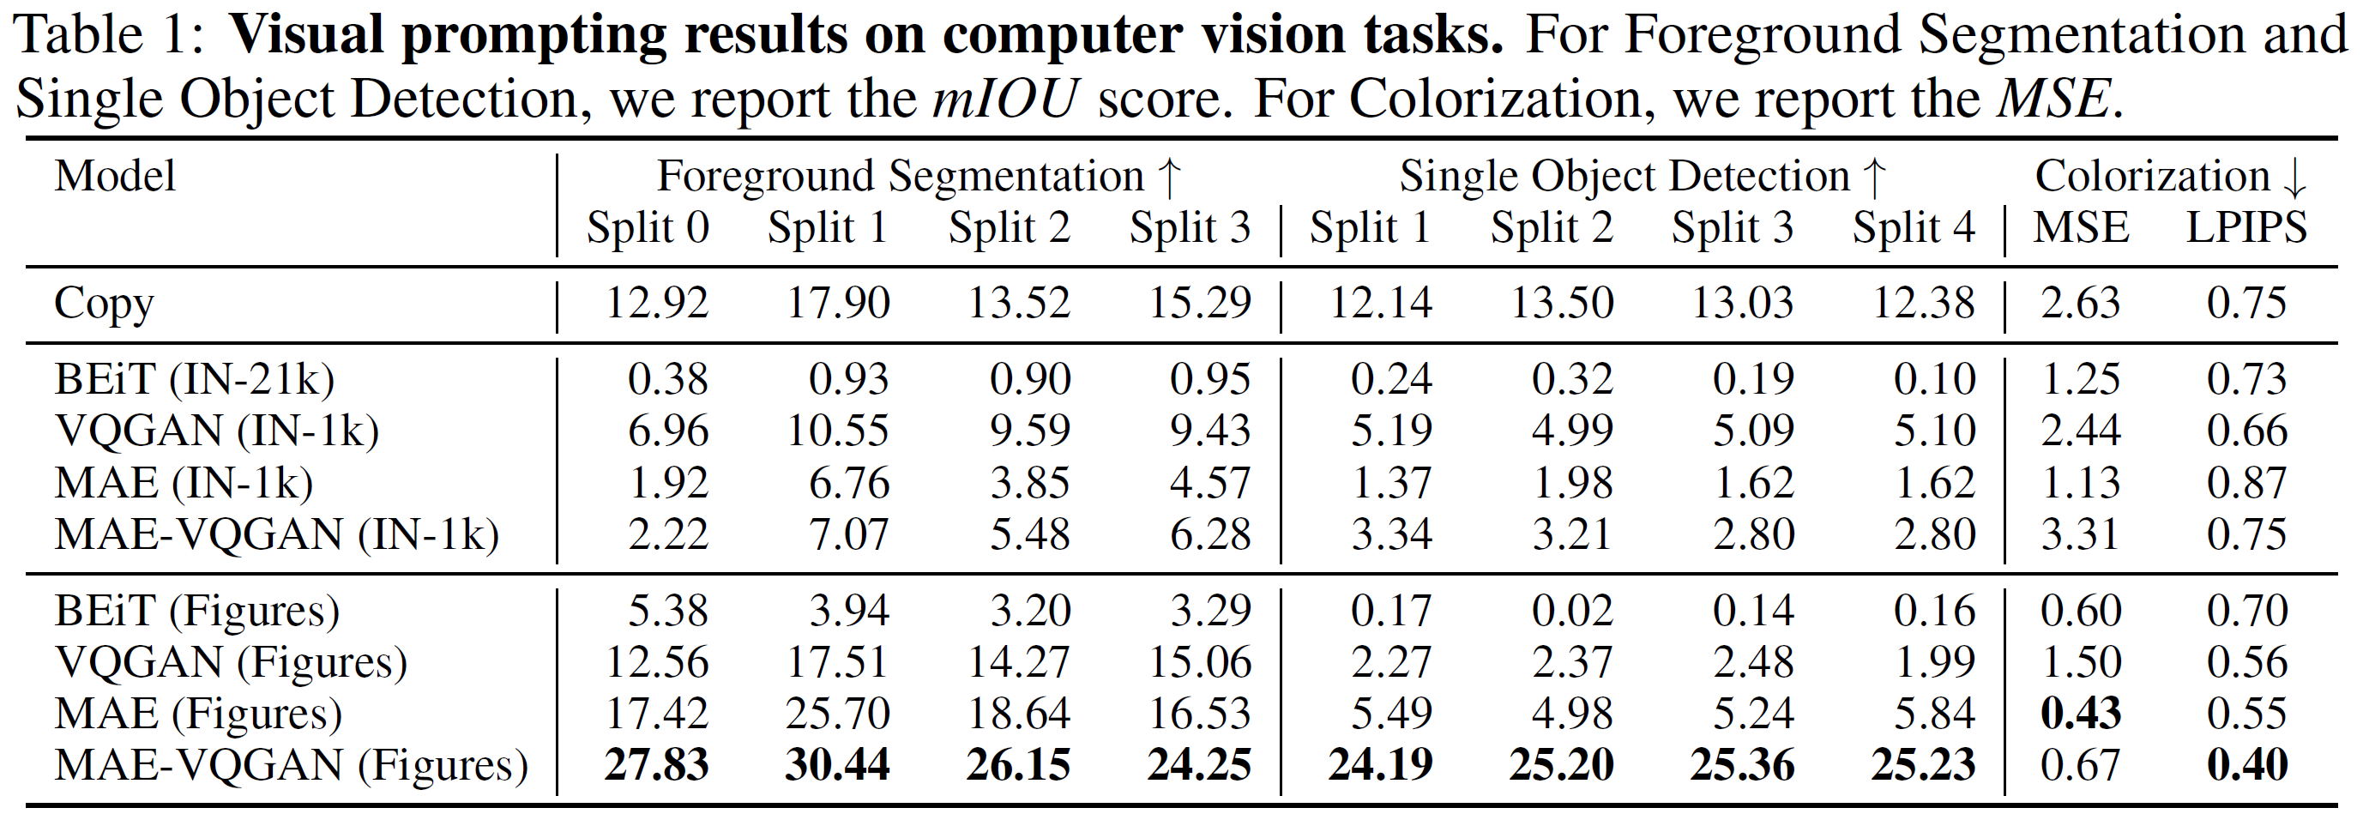
Experiments: main result
Three tasks.
Dataset and inpainting model.

Slide 26
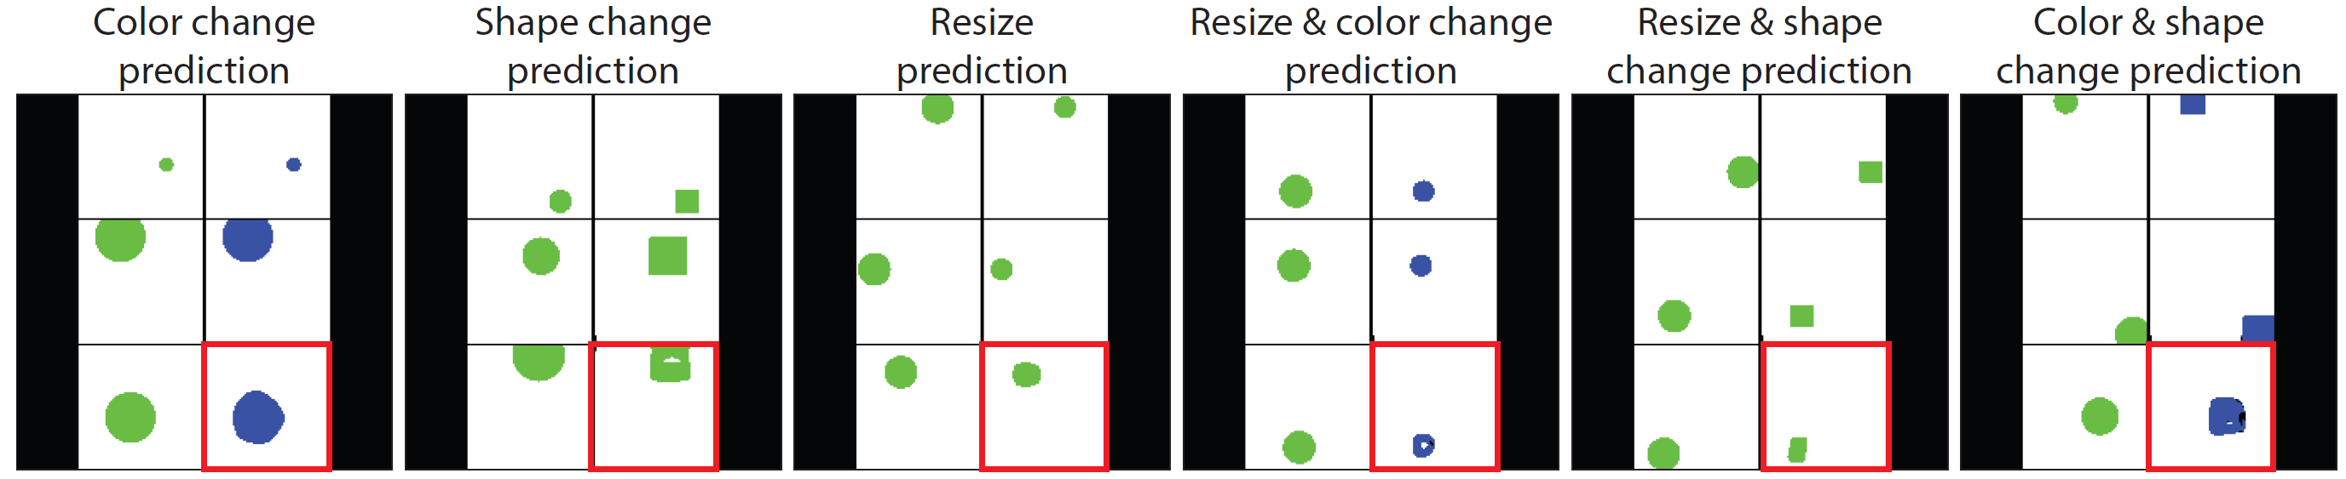
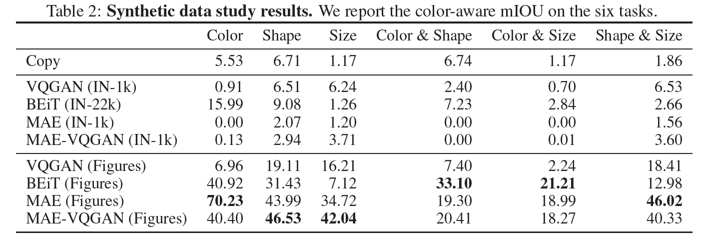
Experiments: synthetic data study and new tasks
Combination and pretraining datasets

Slide 27
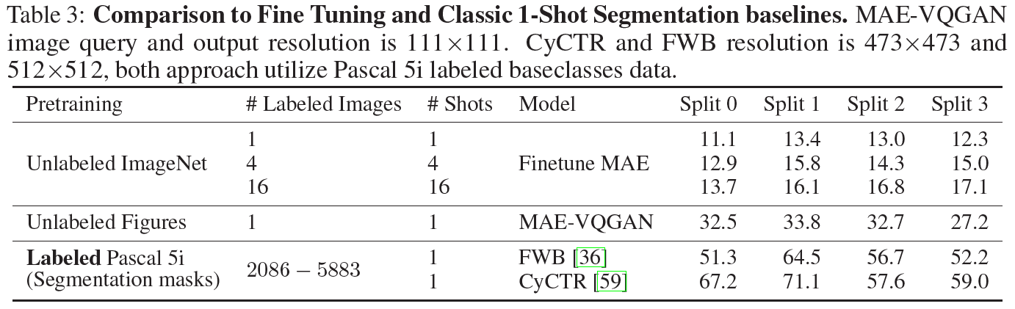
Experiments: analysis
1-shot segmentation

Slide 28
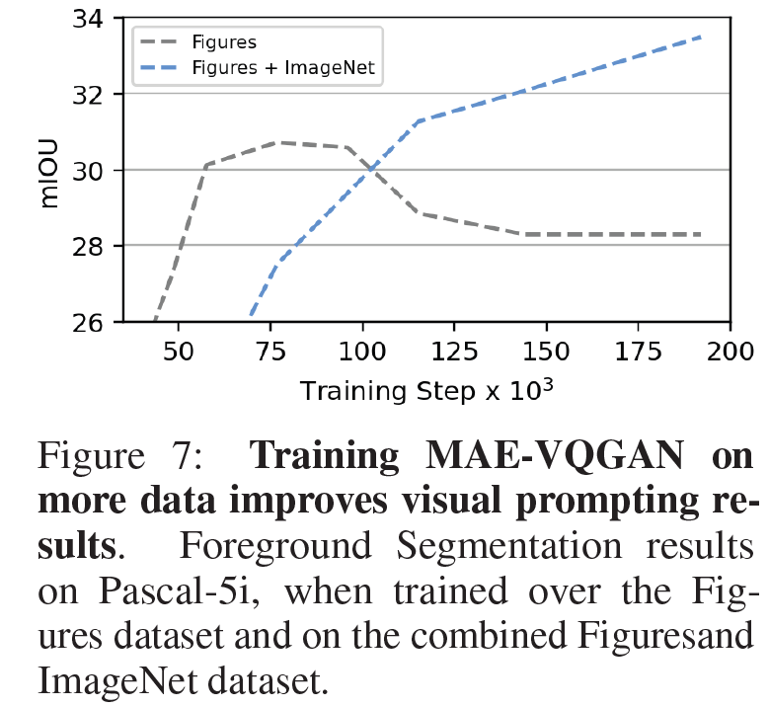
Experiments: analysis of dataset size

Slide 29
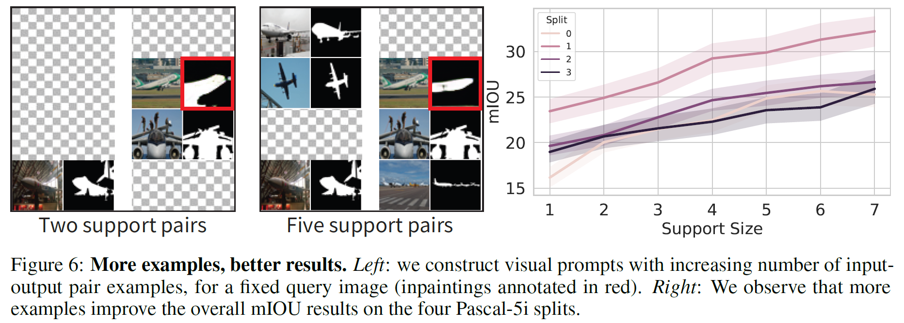
Experiments: analysis of support size

Slide 30
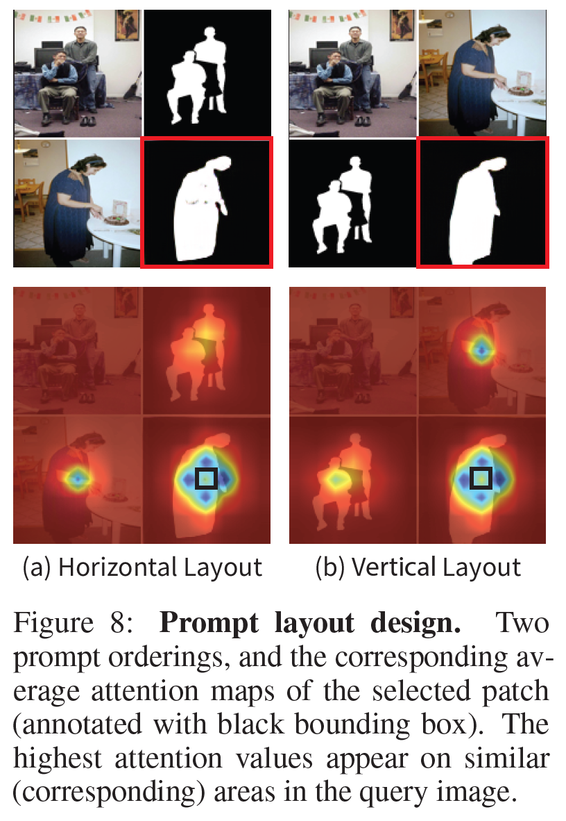
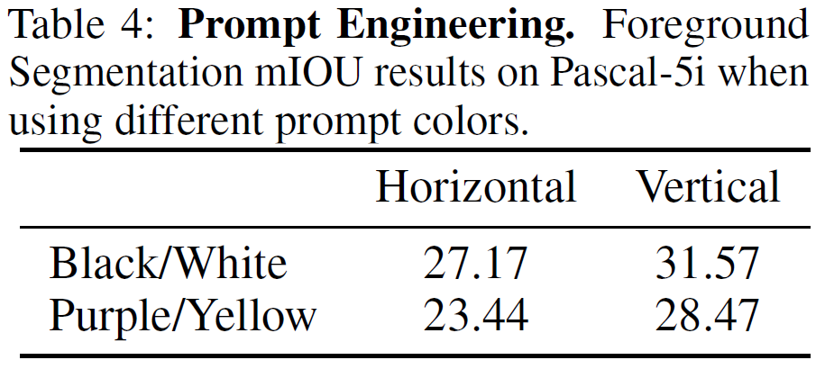
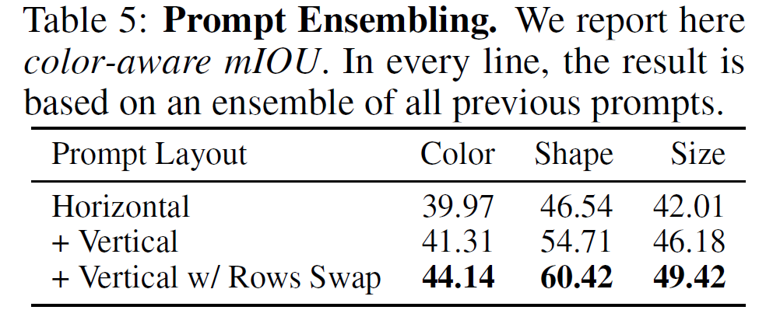
Experiments: analysis of prompting engineering and its ensemble

Slide 31
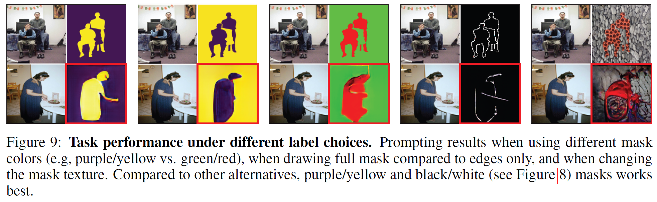
Experiments: analysis of prompting engineering and its ensemble

Slide 32
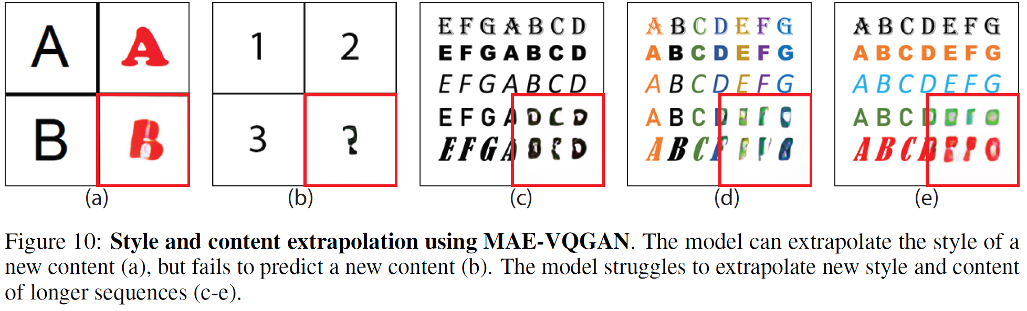
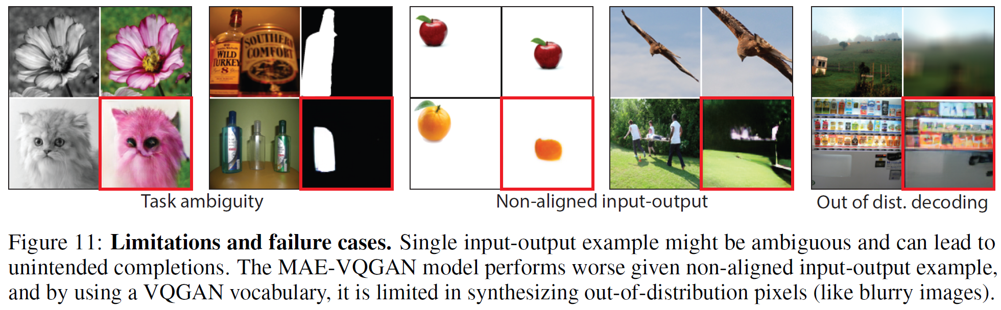
More Experiments and Limitations

Slide 33
Conclusion
Transfer learning and finetuning.
Features.
Computation.
Prompting engineering
with the foundation model
Good semantic-level features.
Need learning.
Only in image classification.
Learning visual prompting
Visual prompting via image inpainting
The pretraining dataset is important.
Without more learning in the testing process.
A unified model for multiple tasks.
Not good enough.

Slide 34
Thank You

Slide 35
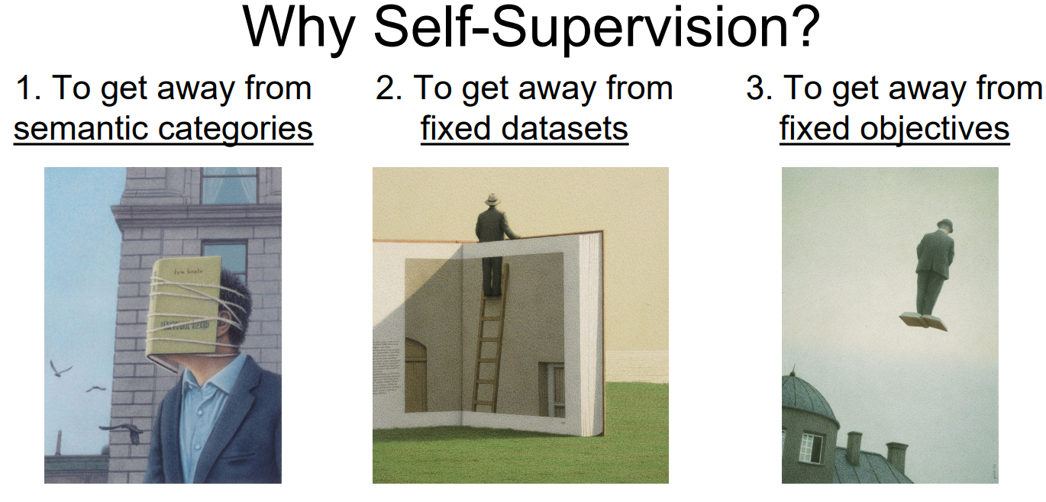
Author
Alexei A. Efros, IEEE Fellow
Focuses on self-supervised learning.
Has deep belief in SSL.
Pix2pix
CycleGAN
SPADE
Colorful Image Colorization
…
ICLR invited talk: Self-Supervision for Learning from the bottom up

Slide 36
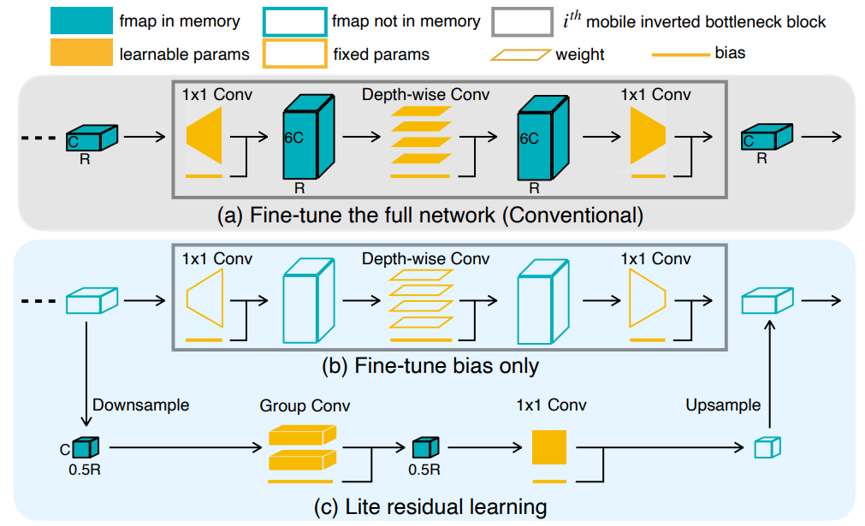
Background: Transfer Learning in CNN
Two more examples to save computation in CNN
Bias-tuning
Cai, Han, et al. "Tinytl: Reduce memory, not parameters for efficient on-device learning." NeurIPS 2020

Slide 37
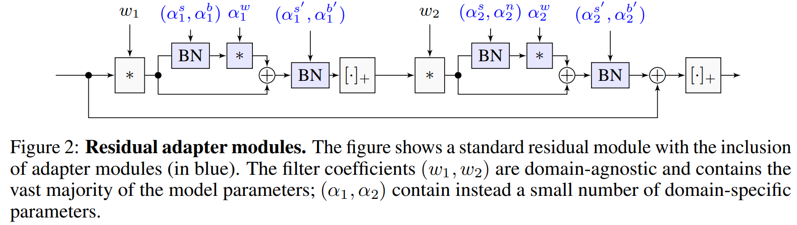
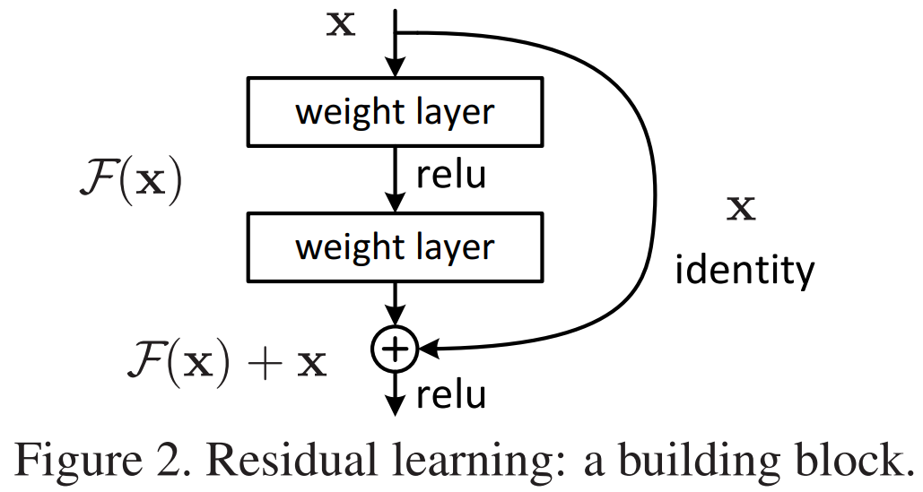
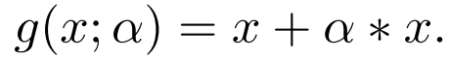
Background: Transfer Learning in CNN
Two more examples to save computation in CNN
Residual adapter
Rebuffi, Sylvestre-Alvise, Hakan Bilen, and Andrea Vedaldi. "Learning multiple visual domains with residual adapters." NIPS 2017.

Slide 38
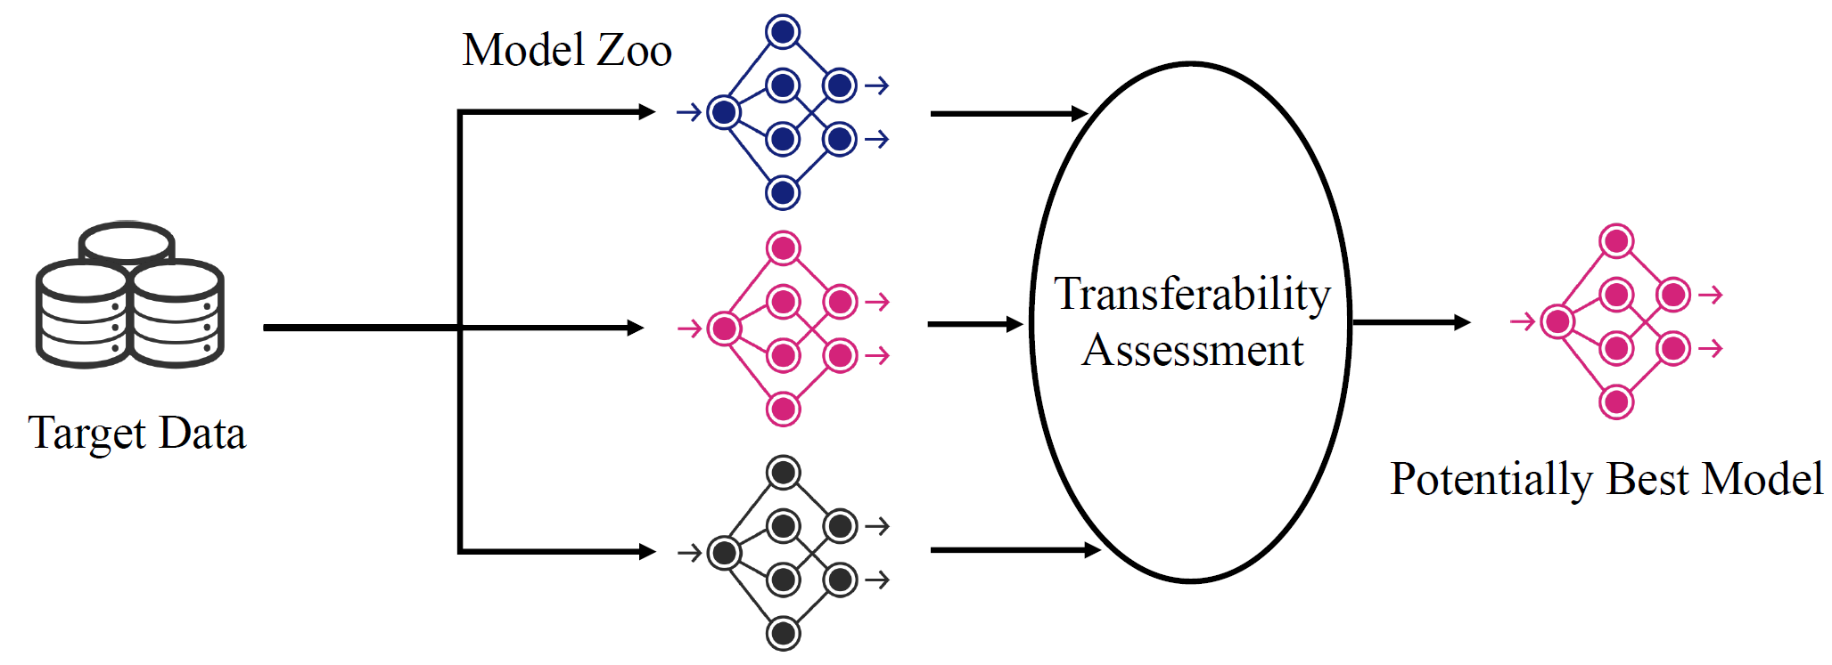
More Challenges in Transfer Learning
For a specific down-stream task:
How to choose the best-pretrained model?
You, Kaichao, et al. "Logme: Practical assessment of pre-trained models for transfer learning." ICML, 2021.

Slide 39
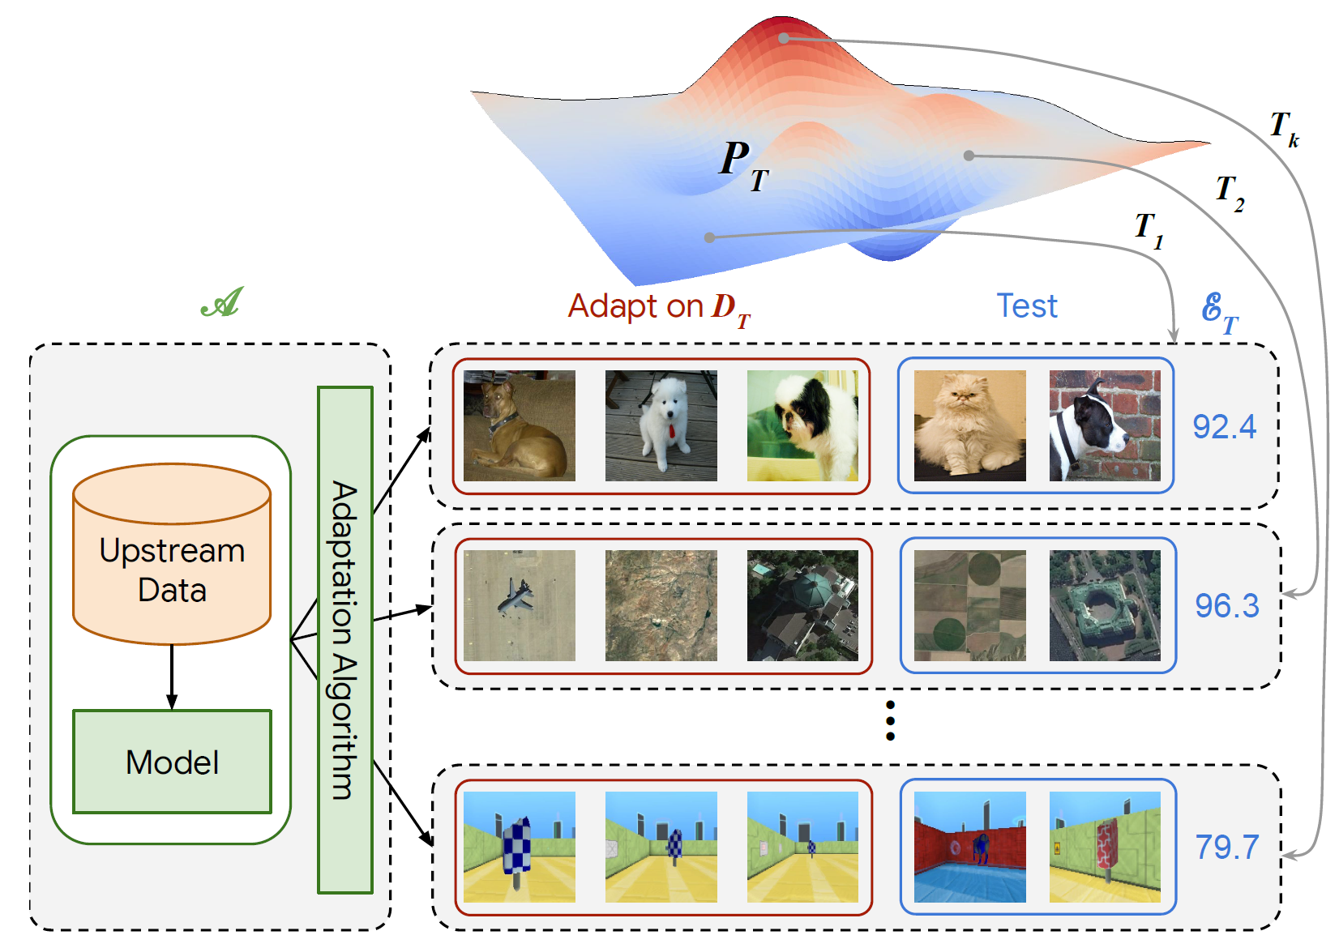
More Challenges in Transfer Learning
To pretrain a model:
How to pre-train a good model for various down-stream tasks?
2020 A large-scale study of representation learning with the visual task adaptation benchmark

